Slide 1
PBSC Update
Powercor REFCL Program

Slide 2
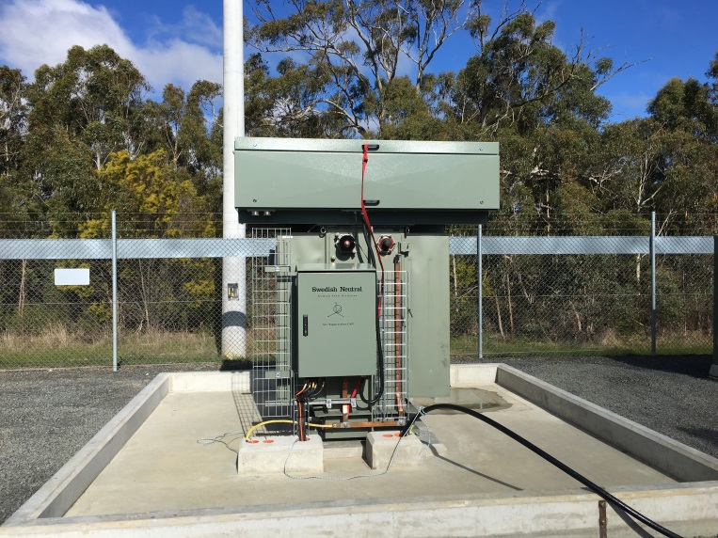
Contents
REFCL Timetable
REFCL T2 Deployment
REFCL Performance update
REFCL General update
SWER ACR Deployment status
Powerline Replacement Fund
Gnotuk Tie 3ph Balancing Unit – CDN003

Slide 3
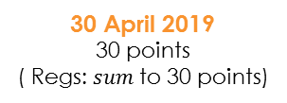
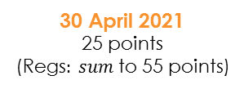
REFCL Timetable
T3 changes
New ZSS
Compliant (conditions resolved)
In service for
summer
In service (TFB only)
10
Tranche 2
Tranche 1
Tranche 3
Tranche 3: possible inclusions & changes
8
Colac - 5
Gisborne - 3
Ararat - 1
Corio - 1
Bannockburn
6
Woodend - 4
Charlton - 2
Geelong - 4
Zone substations commissioned
Eaglehawk- 5
Ballarat South - 5
Koroit - 2
Bannockburn instead of
Corio and Geelong
4
Castlemaine - 4
Bendigo Terminal - 5
Merbein - 1
Maryborough- 5
Bendigo - 1
Stawell - 1
Torquay in addition to
Waurn Ponds
2
Winchelsea - 5
Ballarat North - 4
Hamilton - 2
Camperdown- 4
Terang - 2
Waurn Ponds - 4
Torquay
30 April 2019
30 points
( Regs: $sum$ to 30 points)
30 April 2021
25 points
($\text{Regs}: sum$ to 55 points)
30 April 2023
Balance of points
In-service date

Slide 4
REFCL Deployment timetable – Tranche 2
REFCL thermometer
55
ZSS
PTS
STATUS
REFCL available over summer
BETS
5
T2 deadline
 | 2019 |  |  | 2020 |  |  |  | 2021
 | Q2 | Q3 | Q4 | Q1 | Q2 | Q3 | Q4 | Q1 | Q2 | PTS
CLC |  |  |  |  |  |  |  |  |  | 5
CTN |  |  |  |  |  |  |  |  |  | 2
ART |  |  |  |  |  |  |  |  |  | 1
BGO |  |  |  |  |  |  |  |  |  | 1
TRG |  |  |  |  |  |  |  |  |  | 2
BAN |  |  |  |  |  |  |  |  |  | 4
BAS |  |  |  |  |  |  |  |  |  | 5
BETS |  |  |  |  |  |  |  |  |  | 5
BAS
5
BAN
4
TRG
2
BGO
1
CTN
2
TFB ONLY
ART
1
IN SERVICE
30
CLC
5
IN SERVICE
EHK
WIN
WND
CMN
MRO
CDN
GSB
5
5
4
4
5
4
3
APPROVED
APPROVED
APPROVED
APPROVED
APPROVED
APPROVED
APPROVED
Commissioned
Available
In service
ESV test
Powercor has recently commissioned Charlton and Ararat.
Colac, Ararat and Charlton will be in service this summer (Charlton on TFB days only).
In 2020 there will be eight tranche two stations to test plus seven tranche one stations.
IN SERVICE (TFB ONLY)
IN SERVICE (SUMMER)
APPROCED

Slide 5
REFCL update
Tranche one sites
ESV has lifted all conditions at all tranche one sites, agreeing that we have resolved the issues that led to conditional approval
Summer 2019/20
This summer Powercor will have REFCLs in service at 10 zone substations
The REFCL at Charlton will be in service for TFB days only until the HV customer has completed their REFCL-ready works
Contingent Project Application
The AER has flagged significant cuts to our tranche three funding application
A final decision will be received from the AER by January 2020

Slide 6
REFCL update (continued)
Future exemptions
Bannockburn – exemption application will be submitted on Monday 16 December
Waurn Ponds and Torquay – application to be submitted pending finalisation of preferred solution (Q1 2020)
REFCL performance
Thursday 21 November was a day of state-wide total fire ban including code reds in two districts
We had REFCLs at 8 zone substations in service
REFCLs operated for 10 permanent (6 phase-to-ground) faults plus 32 transient faults
Last summer across 17 TFB days there were 12 REFCL operations (3 permanent phase-to-ground and 9 transient)
The cause of most faults was vegetation (e.g. trees into overhead)

Slide 7
REFCL TFB performance
Thursday 21 November
6 permanent phase-to-ground faults across four REFCL-protected networks
A majority of fault activity occurred between 12 noon and 4pm
The fault data shows a link between some transient faults and permanent ones
12:00
13:00
14:00
15:00
16:00
CMN (6)
EHK (14)
GSB014
14:16
GSB012
14:46
Permanent fault
CMN001
13:20
EHK033
14:05
CMN004
14:36
WND021
15:20
Transient fault (# of)
WND (7)

Slide 8
SWER ACR status
A total of 1,045 SWER systems are to be protected with new functionality ACRs
2016
117 ACRs installed; 50 in the high risk Electric Line Construction Areas
2017
145 ACRs installed
2018
377 ACRs installed
2019
328 ACRs installed, 78 remain. Wet access has hindered completion in 2019 where approximately 40 sites will carry over into 2020. Targeting Q1 2020 completion for all ACRs which is well ahead of the ESV required completion date of November 2020
328 ACRs installed in 2019. Of the 78 remaining, 40 sites will carry over into Q1 2020.

Slide 9
Powerline Replacement
Powerline Replacement Fund
Number of poles retired to date: 1,104
Overhead line retired to date: 319km
Overhead line that Ashbourne South will replace: 16km
Overhead line that future projects will retire: 100km
Total cost: $80m
Projects completed: 28
ELCA annual changes:
Single: -8.9km
Multi: 3.1km
SWER: -71.2km
Commentary
The Ashbourne South project commenced construction in May 2019. Civil works have been completed. Cutover and retirement works planned on 21 November 2019 were cancelled due to the Code Red TFB day. Works are in the process of being rescheduled with completion anticipated in December 2019 or early 2020.
Powercor has commenced further powerline replacement works where a total of 100km of overhead line will be retired by the end of 2020.

